Slide 1
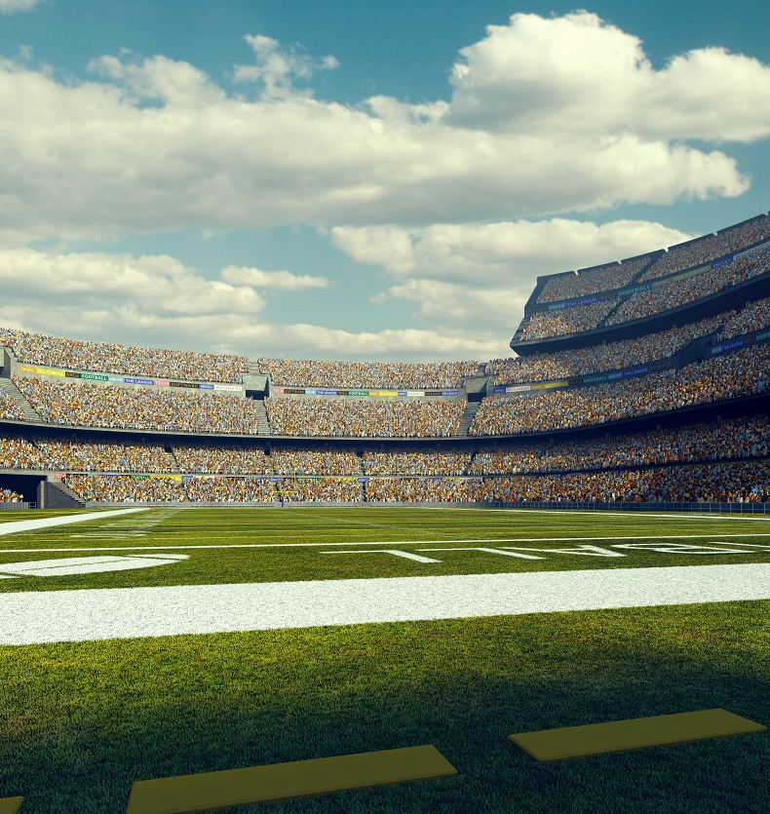
What Wins in the NFL?
By: Michael J. Rodriguez

Slide 2

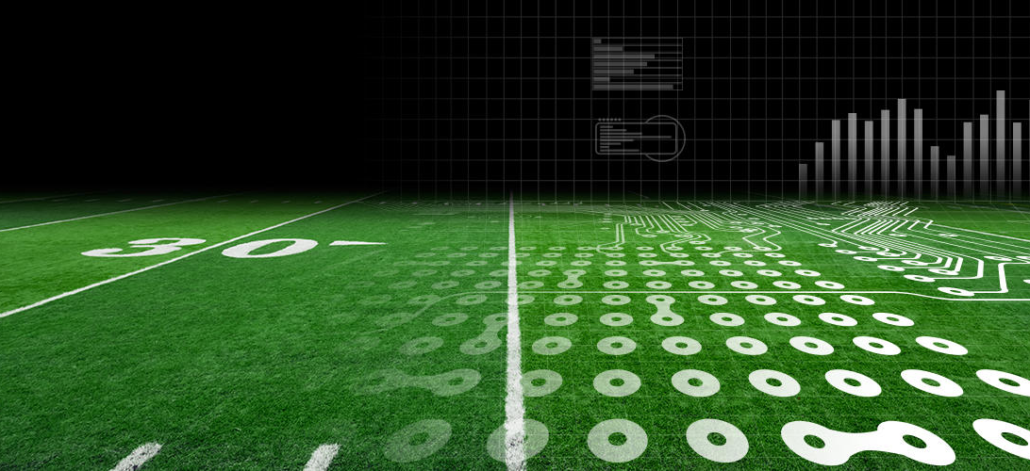

Purpose of Analysis
Find out which metrics correlate with winning in the modern NFL and speculate as to why this is
Rank these metrics
Create a list that indicates what NFL teams should prioritize
Compare results with common talking points
Satisfy personal curiosity

Slide 3
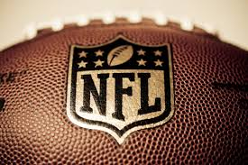
Data Overview
The dataset was made by me from a collection of websites including: PFF and OverTheCap
The data collected included stats on
Wins
QB ranking
% of Salary cap paid to QB
Salary cap paid to QB
Average yards for
Defensive Rank
Strength of Division
Turnover Differential
3rd Down Conversion rate
Each metric will be looked at in a specific order, I will start with the ones with the lowest correlation with winning ending on the one that effects winning the most.

Slide 4
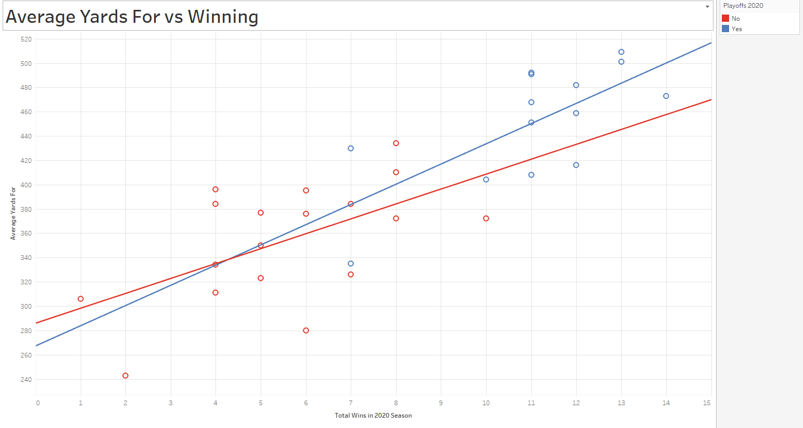
7-9 = Good Team?
Before I show the regression I want to explain why making the playoffs was not considered the mark of a good team
These best of the worst teams win less than non-playoff teams, who arguable are more “deserving” of the playoffs.
These undeserving teams skew data that is trying to find the best teams, and the best teams win the most games.
To the left is an example of what these teams do to a regression analysis.
I will still mention playoff success which I just define as winning 1 playoff game or being the 1st and receiving a bye. So only 8 teams will be consider successful in the playoffs.
Notes:
The blue line indicating the relationship between winning and average yards for, among playoff teams has a weaker relationship (.69) than the relationship when all teams are included because undeserving teams are included in the filtered line.

Slide 5
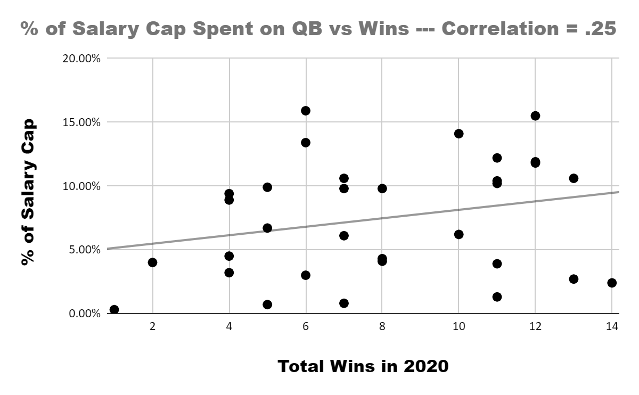
QB Salary Cap Hits vs Winning – 7th
I combined the two metrics about the salary cap because the results of both were nearly identical
Weak correlation here of just .25
The idea that bloated QB salaries lead to worse outcomes is incorrect assuming that the QB being paid is worth the salary hit
We see 2 distinct clusters at the high win margins, below the line are the Chiefs, Ravens and Bills who all had cheaper younger QB’s.
Above that we see teams like the Packers and Seahawks who reward Russ and Rodgers well but still see good returns.
Seahawks
Packers
Ravens
Bills
Chiefs
Key takeaway: paying the right guy enough money to stay is better than paying pennies to the wrong guy or giving Kirk Cousins 100 million dollars.

Slide 6
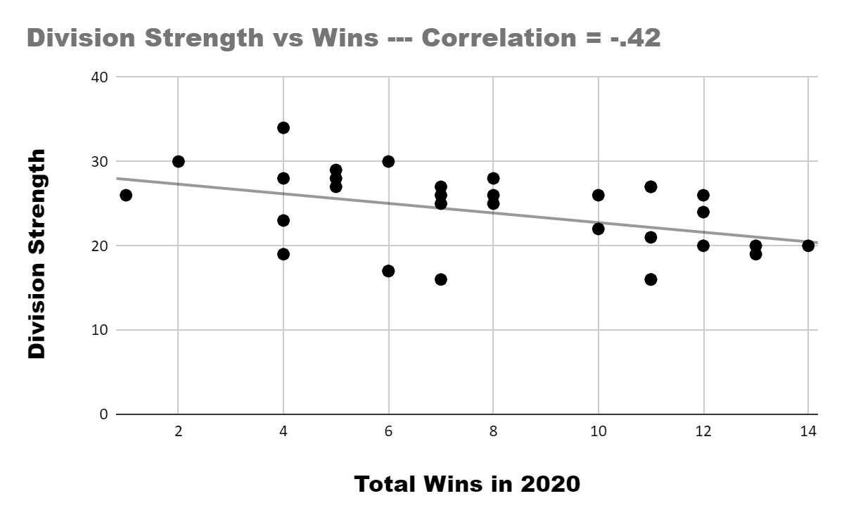
Division Strength vs Wins – 6th
Metric represents the sum of the other 3 teams in the division for all 32 teams for the 2020 season
Moderate correlation of -.42
Interdivision dysfunction seems to allow some teams to do better on average.
One issue is that division games have a larger effect on the data as a Browns win over the Steelers leads to a +1 for the Browns and a -1 for the Steelers
Another issue is that great teams will make there division rivals look worse and so teams who perform less may fire coach's or bench players, leading to more instability and less wins.
Key takeaway: Having a softer division makes 6 of a teams games easier to win but interdivision rivalries and a lack of clear causality makes this tough to pin down.

Slide 7
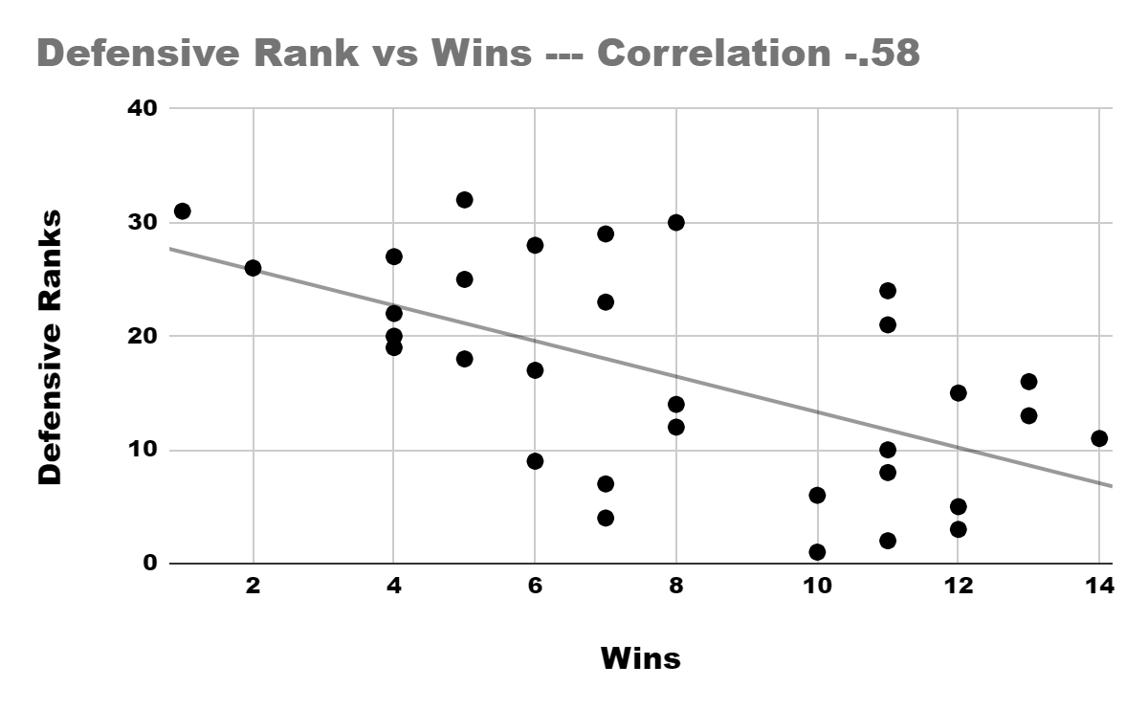
Defensive Rank vs Wins – 5th from Pro Football Reference
PFR list used because it was the most complete ranking system that took into account everything from yards allowed to amount of penalty yards.
Solid correlation of -.58
Defense may not win championships anymore as in the playoffs only 5 of the 13 games were won by the team with the superior defense in 2020
I think that the relationship can be explained by the fact that Defensive rank correlates well with a teams Turnover Differential, creating a better time of possession for a team.
Key takeaway: While defense is still key to success for a competitive team, the prevalence of offense cannot be denied in the modern NFL.

Slide 8
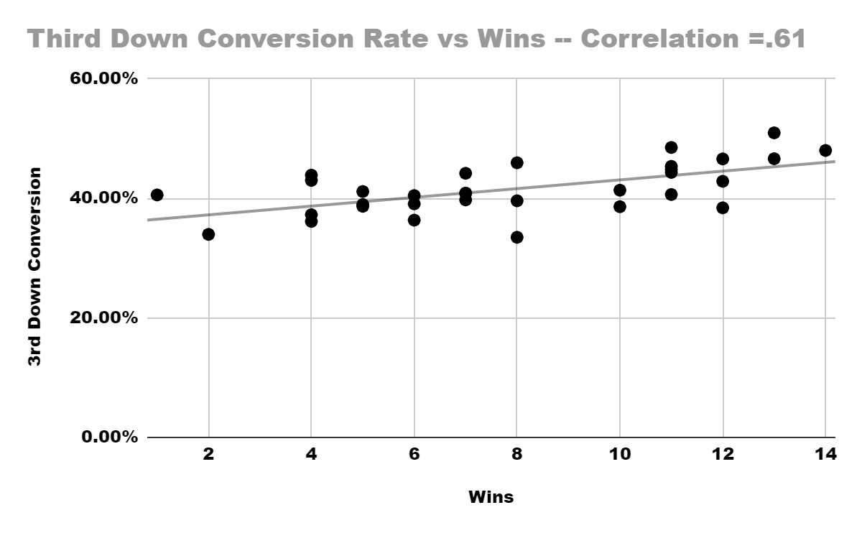
Third Down Conversion Rate – 4th
TDCR was included because I think the feeling of relief that the offense is getting another set of downs may help the morale of teams more than we think
TDCR also measures how long an offense can stay on the field and the quality of coaching and offensive play calling
Stronger correlation at .61
Of the 13 teams with 10+ wins 8 of them were in the top 10 in TDCR
7 of the 8 successful playoff teams were in the top 10 of TDCR
Key takeaway: Winning teams stay on the field and get enough 3rd downs to at least get a field goal.

Slide 9
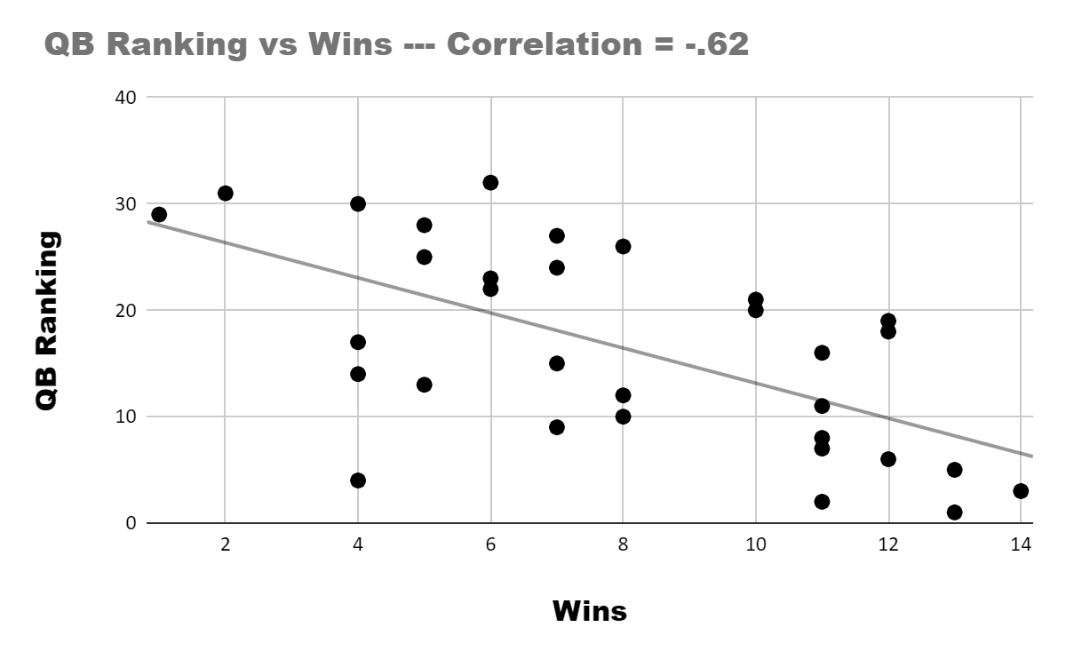
QB Rank – 3rd per PFF
Stronger correlation at -.62
QB rank had to be included as the league values this position more than ever because the top 11 paid players are all QB’s
5 of the 8 successful playoff teams had a top 10 QB
In the playoffs 11 of the 13 games were won by the team with the higher ranked QB
One issue that I can see with this metric is that depending on which ranked list you will find different results.
Key takeaway: The common belief that QB is the most critical player on the field is true. This fact is even more true in the playoffs.

Slide 10
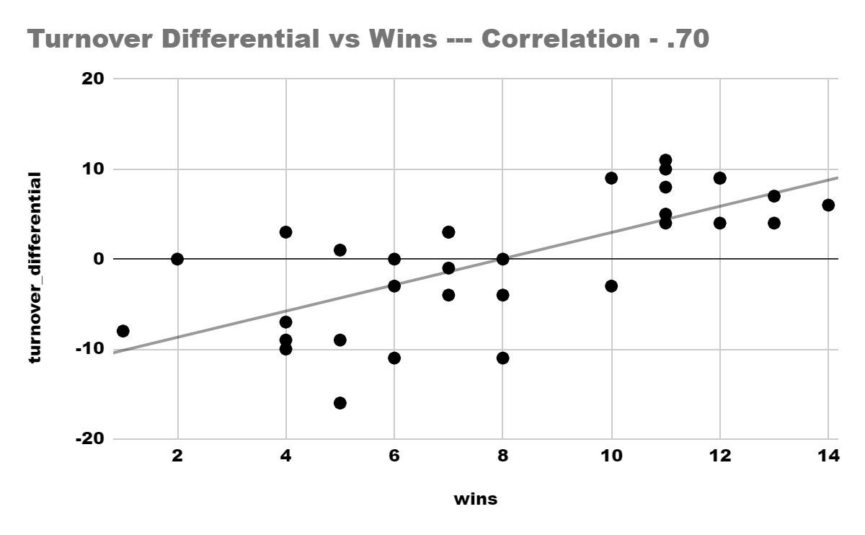
Turnover Differential – 2nd
TD was included because it is a way to see the effect of ball security mixed with an opportunistic defense
Strong correlation at .70
Of the top 10 teams in terms of TD, 8 of them were playoff teams and 6 of them were successful playoff teams
There was only one team with both 10+ wins and a negative TD (LA Rams)
The regular season win rates of teams with a TD<0, TD=0 and TD>0 are
36.06% ---- <0
33.33% ---- =0
64.06% ---- >0
Key takeaway: The best teams protect the ball and maximize the number of drives they have in a game. The corr of -.41 between TD and QB ranking and the corr of -.53 between TD and Def Rank shows that takeaways influence TD more than giveaways

Slide 11
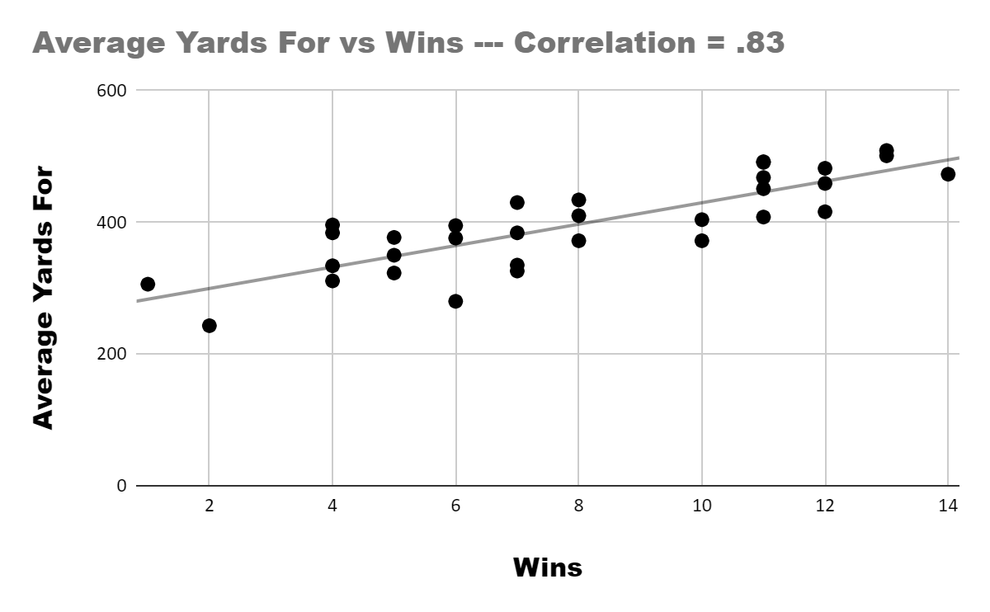
Average Yards For – 1st
Of the metrics used had the strongest correlation at .83
One worry I have is that this relationship is so connect with other factors that it is spurious
I wanted to see if the NFL is now a league that is run by the offense and based on what I see, it seems to be the case as
All teams in the top 10 in AYF were playoffs teams
Only 1 team had 10+ wins and was in the bottom half of the league in AYF
Of the 13 playoff games 9 were won by the team with a higher AYF
Key takeaway: If you want to win the NFL moving the ball down the field well is the best way to do so. A stagnant offense likely punts backed up, giving the other team better field position.

Slide 12
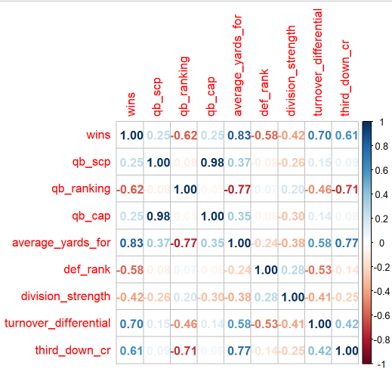
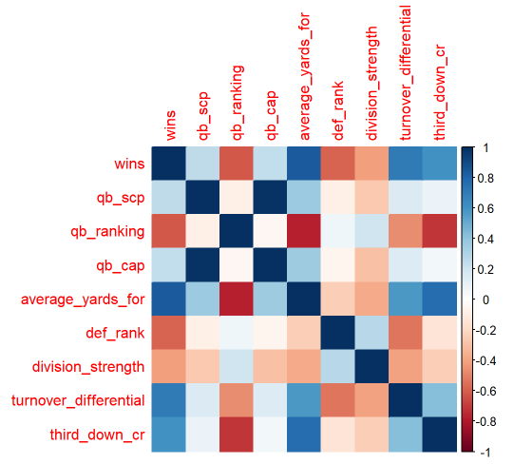
The Data
The correlations were done in R via the corrplot function and a few graphics were made to make them more digestible.

Slide 13
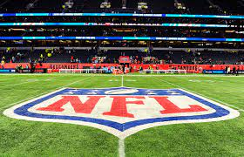
Closing Thoughts
The 2 most common talking points from NFL “analysts” are wrong from what we see
Paying a QB well does not prevent a team from doing well
From what we see having a weak division does not guarantee success so the argument that the Patriots Dynasty is a product of the division being weak is false
Offense sees to run the modern NFL, the odds of having a weak offense is also increased if you lack a solid franchise QB. So the league is both an offensive league and a QB driven league
There are many other factors that I want to include when I revisit this project
One worry I have with this analysis is how complex the metrics are, everyone is connected to all of the others in someway. This makes analysis different as every single factor is influenced by everything else. There are also many other metrics that could replace the ones I included, time of possession could easily substitute for 2 or 3 of the ones I used.

Slide 14
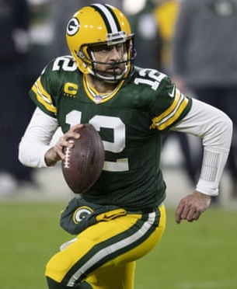
Thank You
Any comments or inquires should be sent to
Michael.rodriguezttu@gmail.com
Feel free to contact me if you just want to talk football or feel strongly about something I included or left out. I would love any feedback.
GO PACK GO!

Slide 15
References and Notes
Offensive Stats
Defensive Stats
Cap Hits
QB ranks
On QB ranks: In order to have each team be labeled between 1-32 I choose the QB who had the majority of the starts, for example Andy Dalton was ranked lower than Dak Prescott but started more games so his ranking was used for the Cowboys.
On Cap Hits: With Cap hits and percentages if the team had more than 1 notable starter they were added together, this occurred with the: Cowboys, Chargers, 49ers, Dolphins
Link to the dataset: NFL Data.csv

